Slide 1
Part 2

Slide 2
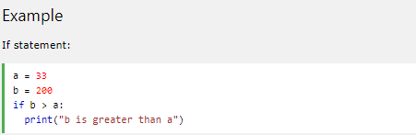
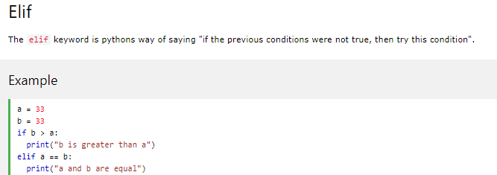
Python If ... Else
If statement:
Python relies on indentation (whitespace at the beginning of a line) to define scope in the code. Java programming language use curly-brackets for this purpose.

Slide 3


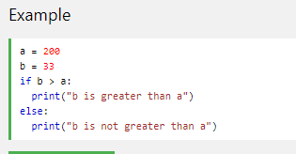

Python If ... Else
If statement:
Python relies on indentation (whitespace at the beginning of a line) to define scope in the code. Java programming language use curly-brackets for this purpose.

Slide 4
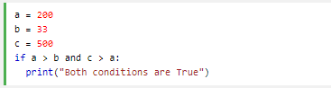

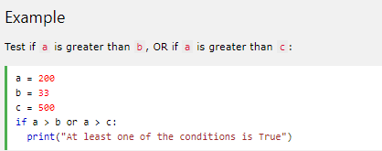

Python If ... Else
And
The and keyword is a logical operator, and is used to combine conditional statements:
Or
The or keyword is a logical operator, and is used to combine conditional statements:

Slide 5
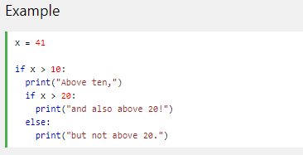
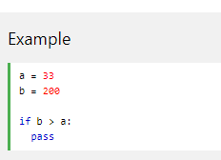
Python If ... Else
Nested If
You can have if statements inside if statements, this is called nested if statements.
The pass Statement
if statements cannot be empty, but if you for some reason have an if statement with no content, put in the pass statement to avoid getting an error.
Notes:
להעיר שהתבלבלתי שבוע שעבר בנוגע לpass, משתמשים בו כדי לא לקבל שגיאה כשתנאי ריק

Slide 6
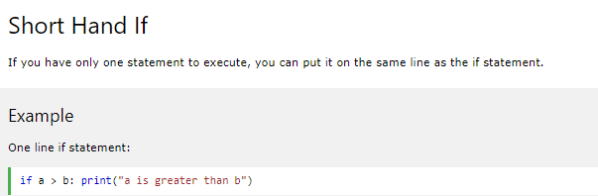
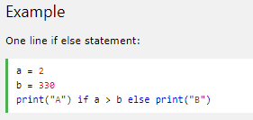
Short Hand If
If you have only one statement to execute, you can put it on the same line as the if statement.
Short Hand If ... Else
If you have only one statement to execute, one for if, and one for else, you can put it all on the same line:

Slide 7
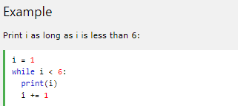
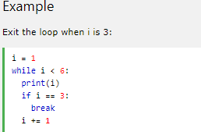
Python While Loops
The while Loop
With the while loop we can execute a set of statements as long as a condition is true.
The while Loop
With the while loop we can execute a set of statements as long as a condition is true.

Slide 8
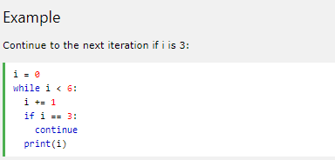
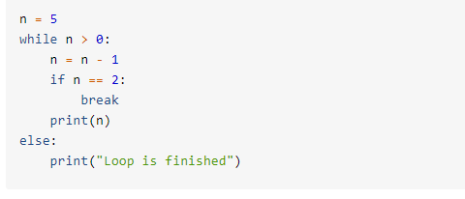
Python While Loops
The continue Statement
With the continue statement we can stop the current iteration, and continue with the next:
while-loop-else-clause, which is unique to Python. The else-block is only executed if the while-loop is exhausted.

Slide 9
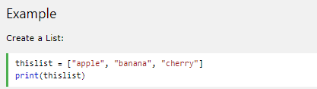
Python Lists
List
Lists are used to store multiple items in a single variable.
Lists are one of 4 built-in data types in Python used to store collections of data, the other 3 are Tuple, Set, and Dictionary, all with different qualities and usage.
Lists are created using square brackets:
List items are ordered, changeable, and allow duplicate values.
List items are indexed, the first item has index [0], the second item has index [1] etc.\
Ordered
When we say that lists are ordered, it means that the items have a defined order, and that order will not change.
If you add new items to a list, the new items will be placed at the end of the list.
Note: There are some list methods that will change the order, but in general: the order of the items will not change.
Changeable
The list is changeable, meaning that we can change, add, and remove items in a list after it has been created.
Allow Duplicates
Since lists are indexed, lists can have items with the same value.

Slide 10

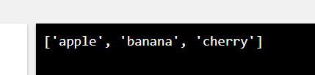


Python Lists
The list() Constructor
It is also possible to use the list() constructor when creating a new list.

Slide 11
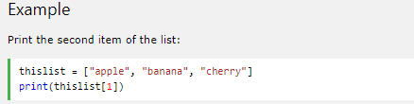
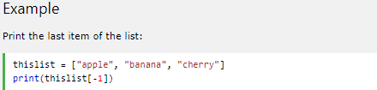
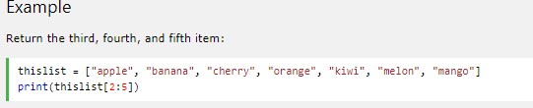
Python - Access List Items
Access Items
List items are indexed and you can access them by referring to the index number:
Negative Indexing
Negative indexing means start from the end
-1 refers to the last item, -2 refers to the second last item etc.
Negative Indexing
Negative indexing means start from the end
-1 refers to the last item, -2 refers to the second last item etc.
Note: The search will start at index 2 (included) and end at index 5 (not included).

Slide 12

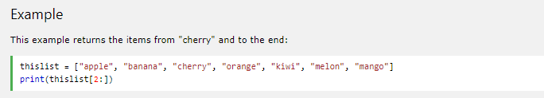
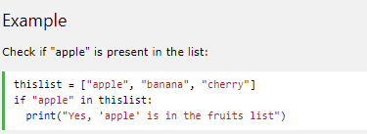
Python - Access List Items
Example
This example returns the items from the beginning to, but NOT included, "kiwi":
Check if Item Exists
To determine if a specified item is present in a list use the in keyword:

Slide 13
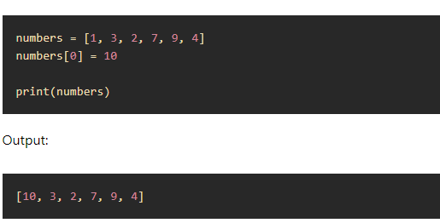
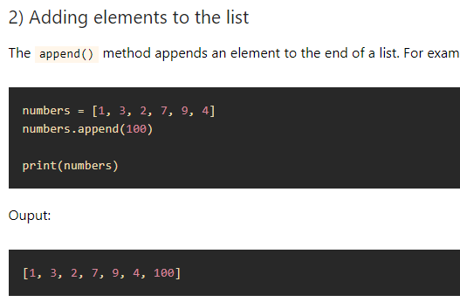
Modifying elements in a list

Slide 14
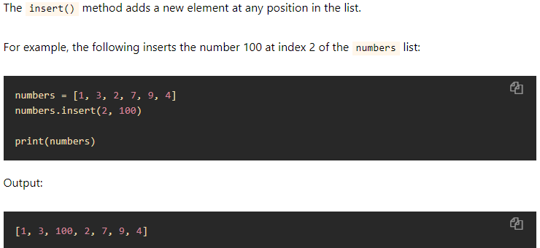
Modifying elements in a list

Slide 15
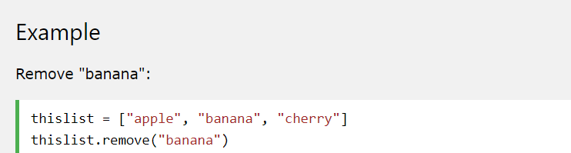
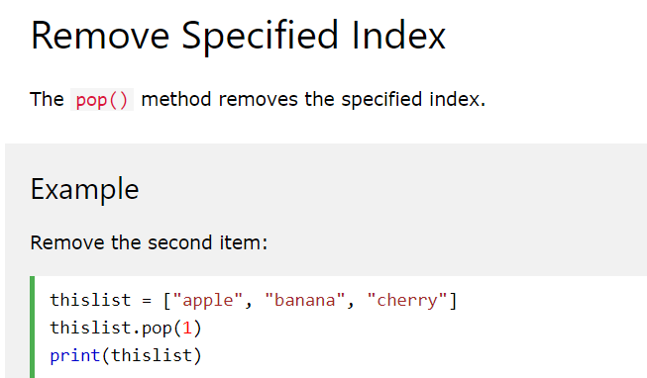

Removing elements from a list
The remove() method removes the specified item.
The remove() method removes the specified item.

Slide 16
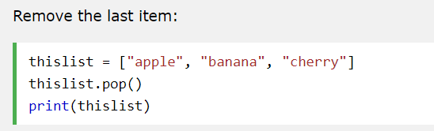
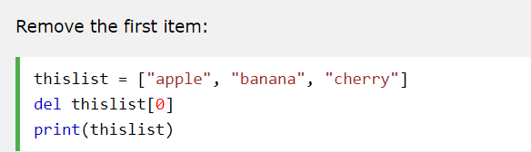
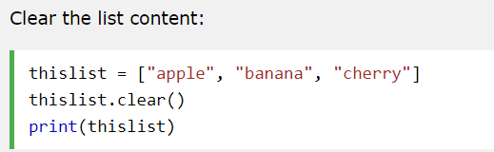
Removing elements from a list
If you do not specify the index, the pop() method removes the last item.
Remove the first item
The clear() method empties the list.
The list still remains, but it has no content.

Slide 17
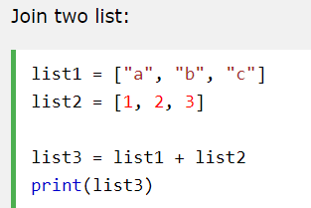
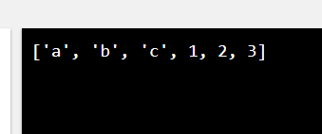
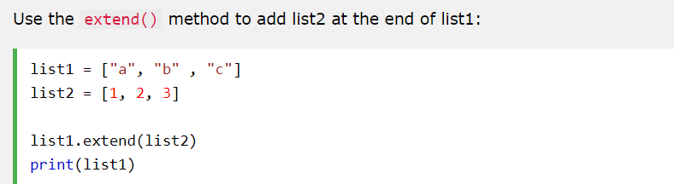
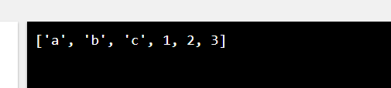
Join Two Lists
There are several ways to join, or concatenate, two or more lists in Python.
One of the easiest ways are by using the + operator.
Use the extend() method to add list2 at the end of list1:

Slide 18
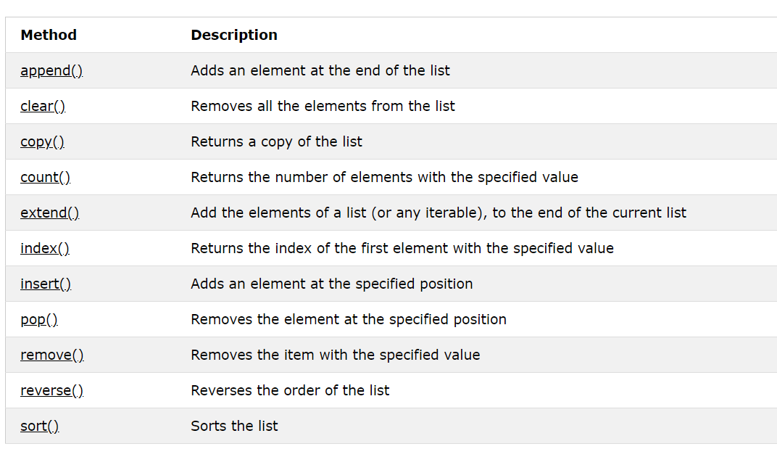
List Methods
Python has a set of built-in methods that you can use on lists.

Slide 19
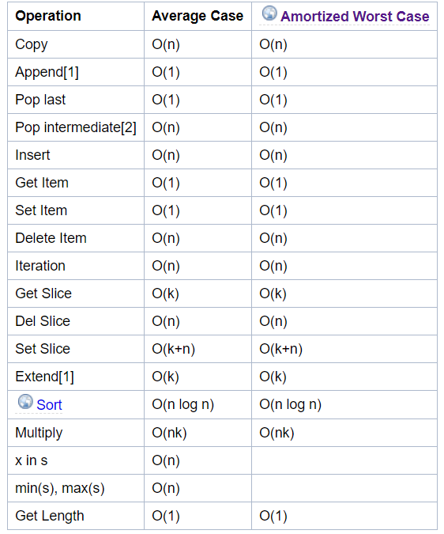
List Methods Complexity

Slide 20
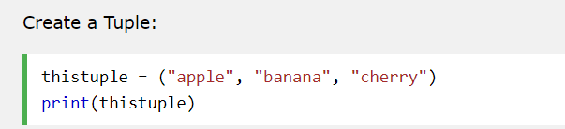
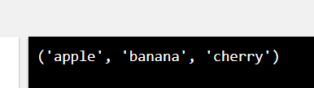
Python Tuples
Tuples are used to store multiple items in a single variable.
A tuple is a collection which is ordered and unchangeable.
Tuples are written with round brackets.
Tuple items are ordered, unchangeable, and allow duplicate values.
Tuple items are indexed, the first item has index [0], the second item has index [1] etc.
Ordered
When we say that tuples are ordered, it means that the items have a defined order, and that order will not change.
Unchangeable
Tuples are unchangeable, meaning that we cannot change, add or remove items after the tuple has been created.
Allow Duplicates
Since tuple are indexed, tuples can have items with the same value:

Slide 21
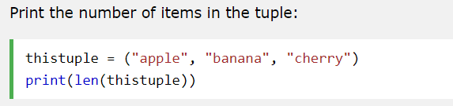
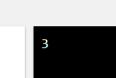
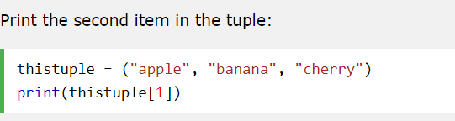
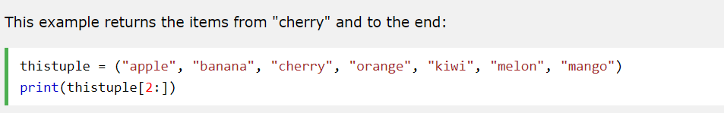
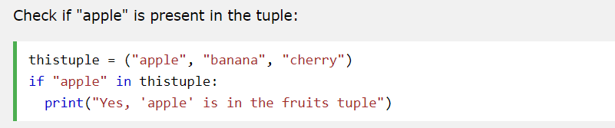
Python Tuples
To determine how many items a tuple has, use the len() function:
Access Tuple Items
You can access tuple items by referring to the index number, inside square brackets:

Slide 22
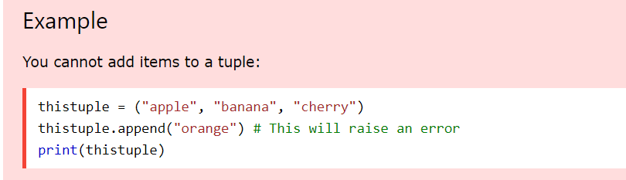
Change Tuple Values
Once a tuple is created, you cannot change its values. Tuples are unchangeable, or immutable as it also is called.
Tuples are unchangeable, so you cannot remove items from it

Slide 23
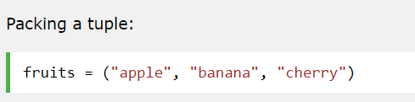
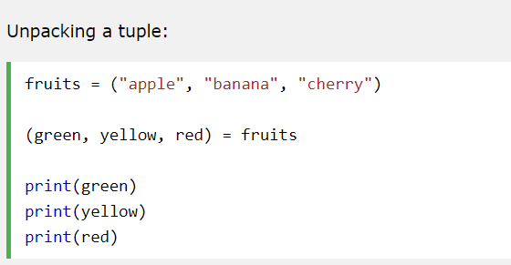
Python - Unpack Tuples
Packing a Tuple
When we create a tuple, we normally assign values to it. This is called "packing" a tuple:
Unpacking a Tuple

Slide 24
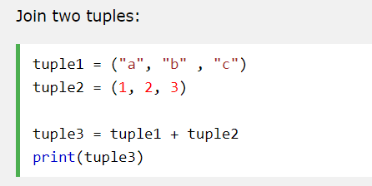
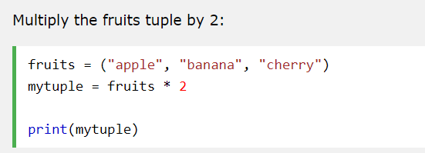
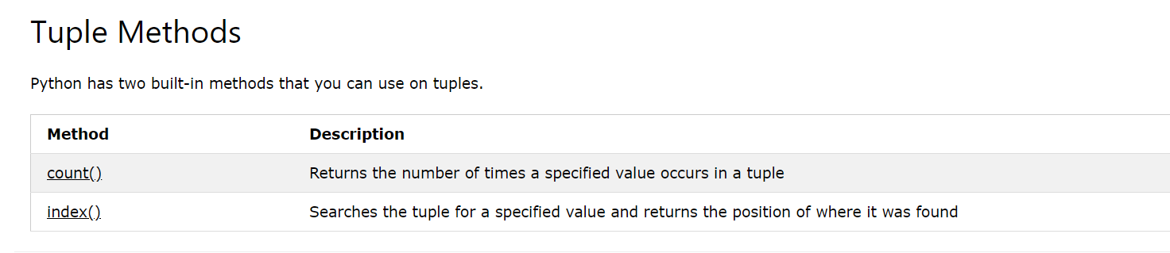
Tuples
To join two or more tuples you can use the + operator
If you want to multiply the content of a tuple a given number of times, you can use the * operator:

Slide 25
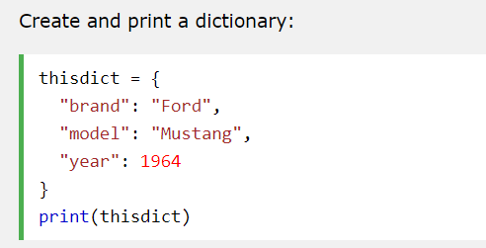
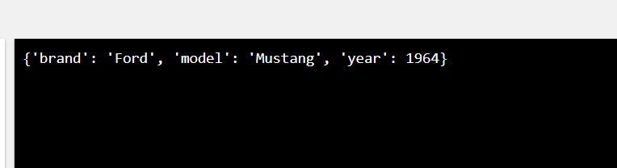
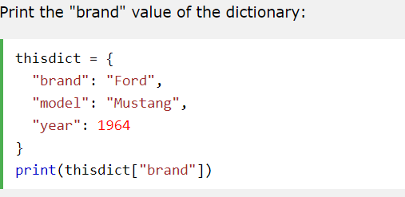

Python Dictionaries
Dictionaries are used to store data values in key:value pairs.
A dictionary is a collection which is unordered, changeable and does not allow duplicates.
Dictionaries are written with curly brackets, and have keys and values:
Dictionary Items
Dictionary items are unordered, changeable, and does not allow duplicates.
Dictionary items are presented in key:value pairs, and can be referred to by using the key name.

Slide 26


Python Dictionaries
Unordered
When we say that dictionaries are unordered, it means that the items does not have a defined order, you cannot refer to an item by using an index.
Changeable
Dictionaries are changeable, meaning that we can change, add or remove items after the dictionary has been created.
Duplicates Not Allowed
Dictionaries cannot have two items with the same key:

Slide 27

Python Dictionaries
Dictionary Length
To determine how many items a dictionary has, use the len() function:
Notes:
מה התמונה השנייה מזכירה?

Slide 28



Access Dictionary Items
You can access the items of a dictionary by referring to its key name, inside square brackets:
You can access the items of a dictionary by referring to its key name, using get() method:
The keys() method will return a list of all the keys in the dictionary.
Notes:
לפני שניגשים לערך אסור לשכוח לבדוק אם הוא בכלל קיים

Slide 29


Access Dictionary Items
The list of the keys is a view of the dictionary, meaning that any changes done to the dictionary will be reflected in the keys list.

Slide 30



Access Dictionary Items
Get Values
The values() method will return a list of all the values in the dictionary.
The items() method will return each item in a dictionary, as tuples in a list.

Slide 31





Loop Through a Dictionary
You can loop through a dictionary by using a for loop.
When looping through a dictionary, the return value are the keys of the dictionary, but there are methods to return the values as well.

Slide 32

Dictionary Methods Complexity

Slide 33

python data structures

Slide 34




Python For Loops
A for loop is used for iterating over a sequence (that is either a list, a tuple, a dictionary, a set, or a string).
This is less like the for keyword in other programming languages, and works more like an iterator method as found in other object-orientated programming languages.
With the for loop we can execute a set of statements, once for each item in a list, tuple, set etc.

Slide 35


Python For Loops
With the break statement we can stop the loop before it has looped through all the items:
With the continue statement we can stop the current iteration of the loop, and continue with the next:

Slide 36






Python For Loops The range() Function
To loop through a set of code a specified number of times, we can use the range() function,
The range() function returns a sequence of numbers, starting from 0 by default, and increments by 1 (by default), and ends at a specified number.
To loop through a set of code a specified number of times, we can use the range() function,
The range() function returns a sequence of numbers, starting from 0 by default, and increments by 1 (by default), and ends at a specified number.
The range() function defaults to increment the sequence by 1, however it is possible to specify
the increment value by adding a third parameter: range(2, 30, 3):

Slide 37


Python For Loops
A nested loop is a loop inside a loop.
The "inner loop" will be executed one time for each iteration of the "outer loop":
The pass Statement
for loops cannot be empty, but if you for some reason have a for loop with no content, put in the pass statement to avoid getting an error.

